Slide 1



By Birgit Marbach
Notes:
Hi, my name is Birgit Marbach. First I like to give you some back ground about myself.
I am from Germany, and I am already in Oulu for quite some time.
I am a professional tailor educated in Germany. In Germany I would be called Master -> “Meister”.
I spent the last 35 years working in the field of tailoring, including teaching beginners and experts. I also spent some time in retail.
I am looking for web developers who like to take on my website + shop project which include 2 special tools.

Slide 2

Particularly women are returning to sewing machines. Not because of cost, but because of the enjoyment of creating and the community that surrounds it.
”It is about customization, not so much about the price anymore. It is self-made luxury.” – German sociologist Christian Rauch about the makers-movement.
Notes:
Before we go to the technical side of my project,
I show you some information about the Do-It-yourself industry.
The Do-It-Yourself sewing market is a growing market.
And the DIY outdoor sewing market, is a niche within this market.
Women and but also men like to create their own pieces and customize them to their needs.

Slide 3
Key Market Insights
US Market
Creative Industry market value grew from 30.1 bil in 2011 to 44 bil in 2016.
40% beginners, 50% intermediate.
UK Market
7.7 mil. people consider sewing as a hobby. 1 mil of those only started in the past 3 years.
Market leader for Arts & Crafts in UK (HobbyCraft) reported a 60% increase in sewing & knitting patterns in 2016.
German Market
3 mil. sew, knit or craft at least once a week. 6.7 mil. at least once a month.
Sewing most popular hobby in Germany (overtook knitting)
Notes:
Here are some numbers about the global market.
The US market grow by 46% in the past 5 years.
The market leader is CSS Industry. They have acquired the 4 largest sewing companies called
”The Big Four”: Simplicity, Vogue, McCall and Butterick.
The Uk and German market is also a growing market.

Slide 4
Online tutorials (Youtube) spurred millennials to start learning as they cannot learn elsewhere.
Google Keywords: generic terms ”sewing”, ”sewing patterns” and ”sewing tutorial” in decline.
Google Keywords: specific searches ”bomber jacket sewing jacket” (↑800%) and ”sewing near me” (↑ 5000%) increased. Customers have ideas and want help realizing these, and they seek a community.
Digital Insights
Notes:
In Finland handycrafts is still touhgt in schools but in many other countries it is not.
So DIY enthusiast turn to the internet to learn.
They use very specific keywords to find instructions, tutorials or places near by to learn sewing or other types of handicraft.

Slide 5

Most ideas for clothing and gear
arise during adventures.
Notes:
Most outdoor enthusiasts come up with an idea on how to improve their clothing and gear during a trip.
Thus they like to make these improvements and test them on their next trip.
When they search for outdoor patterns, they discover,
that there are not many outdoor patterns on the market and the exciting ones are multiple years old, look quite old fashioned
and take weeks to arrive, as they only exists in paper versions.

Slide 6
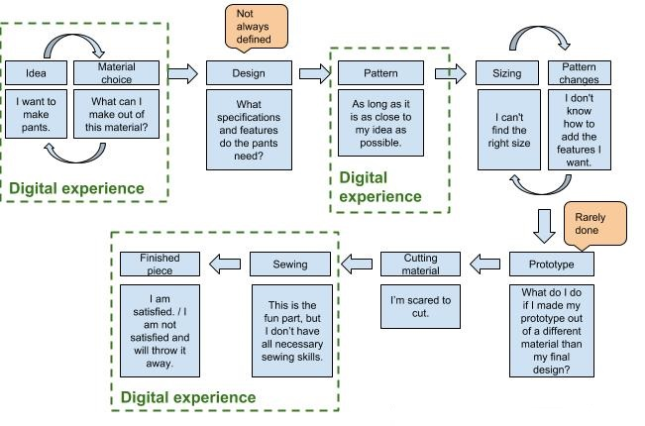
Typical Customer Journey
Notes:
During my 35 years of teaching in this industry, I discoverd that this is the typical pathway of a DIYer today.
You can clearly see the digital experience now-a-days.

Slide 7

Pattern Adventure provides a Full Sewing Experience
A New Concept for the DIY Sewing Market: Helping Outdoor Enthusiasts create the clothing and gear they need for their adventures.
Idea
Research & Sewing
Realization
Notes:
Pattern Adventure is going to provide the full sewing experience.
This is a new concept.
I like to pick the DIYer up right away when they take their idea to the internet and search for a solution.
So from idea to realization.

Slide 8
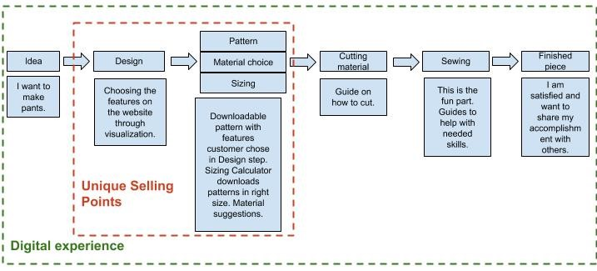
Improved Customer Journey
Notes:
My new holistic solution will maximize the enjoyable sewing steps and
minimize the frustrating steps.
I like to realize this by building a website, including a web shop.
.

Slide 9
Website and Shop
PDF Downloadable Patterns
Sewing Guides and Tutorials
Fabric and Material Recommendations
Notes:
The webshop will have PDF downloable patterns, sewing guides and tutorials
plus farbic and material recommendations.

Slide 10
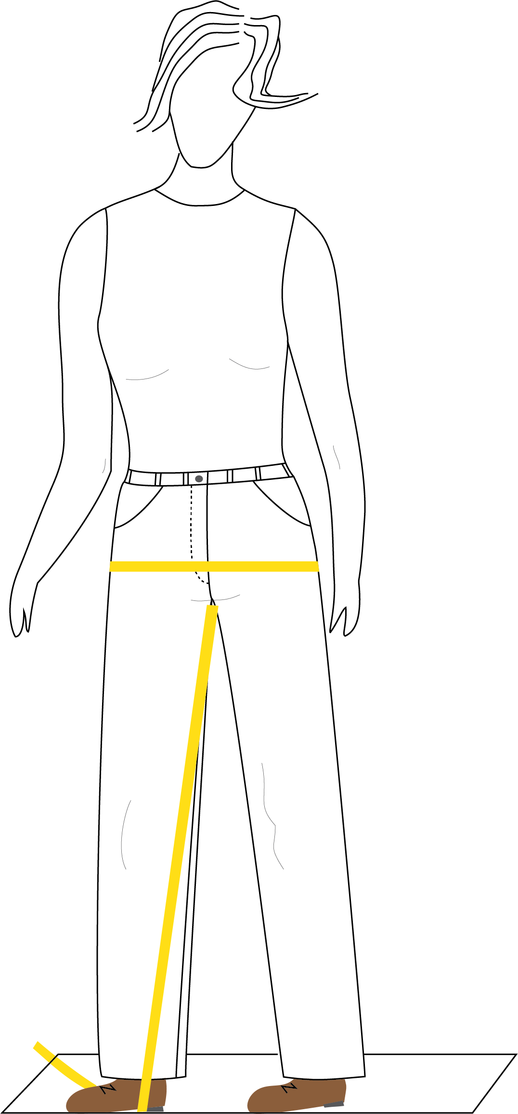
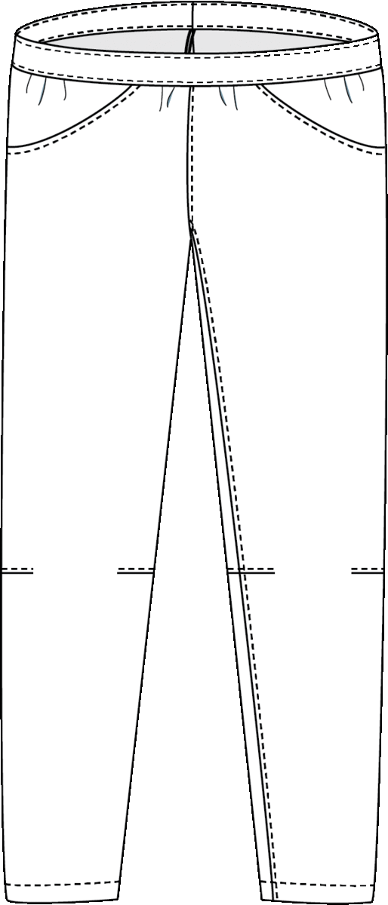
Sizing Calculator
Visualization Tool
Website Tools
Notes:
It will also include these 2 web tools.
The sizing calculator and the visualization tool.

Slide 11

Sizing Calculator
Visualization Tool
Smoothen customer journey
Maximize enjoyable steps
Minimize frustrating parts
Website Tools
Notes:
These 2 tools will help customers to realize their ideas more easily and make the whole process quicker and enjoyable.
They give the customer a digital experience.
Both tools together form the base for the holistic solution.

Slide 12
Website & Shop Software Requirements
Web Development
Sizing Calculator
Visualization Tool
Notes:
Now, you got some back ground information on the idea of what I like to build.
The next slides show the project more detailed.
So we need to build:
The website/shop
The sizing calulator
And the visualization tool

Slide 13
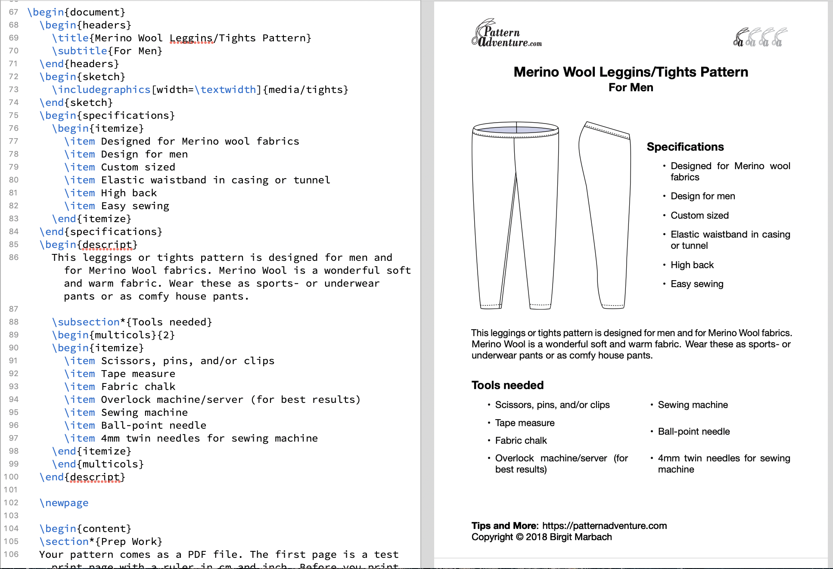
Website development
This is done a little differnet now.
I generate pdf files in affinity publisher.
To write sewing instructions + guidelines
Template to write
Sewing instructions
Guidelines
which include images / drawings
Easy matching of the drawings + images to the text
Easy to use ”Data base”?
Web based Template

Slide 14
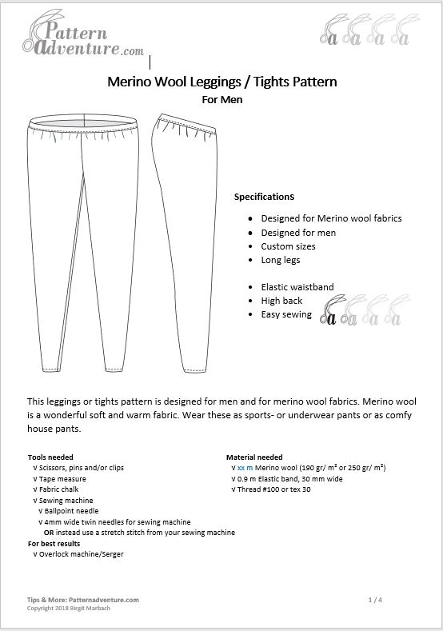
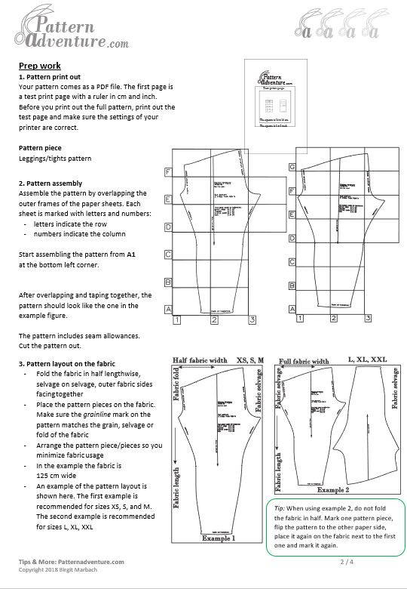
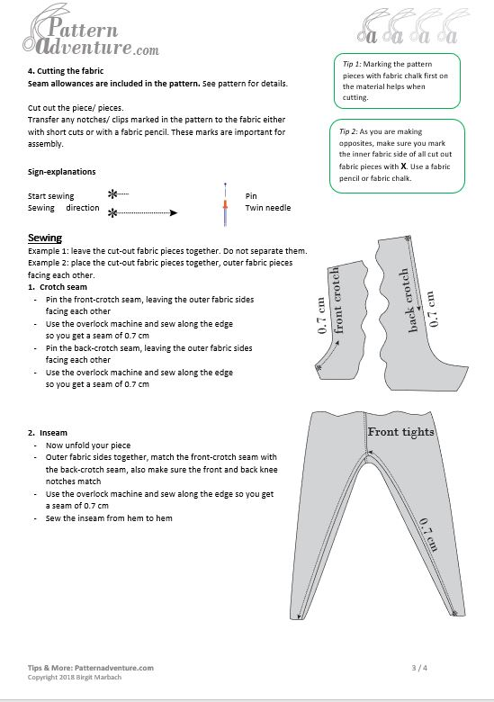
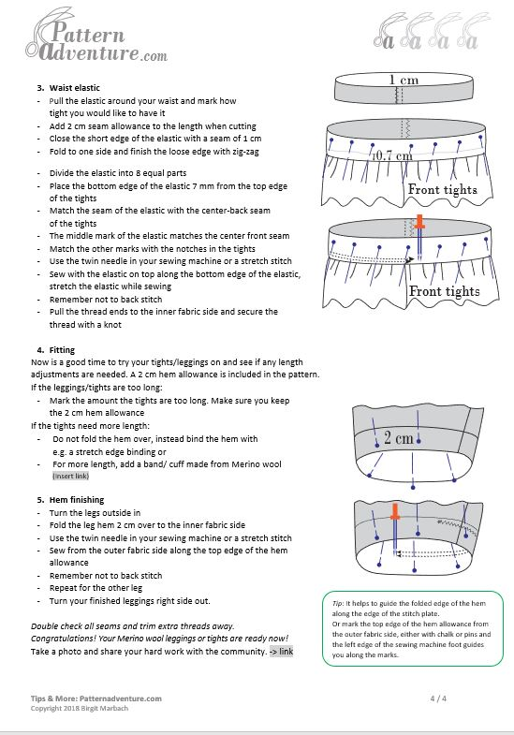
I generate pdf files in affinity publisher.
These documents will be separted into different pdf files. They have to combined again, according to customers choice.
Sewing instructions
Notes:
This shows how I invision the isewing instructions and guides.

Slide 15
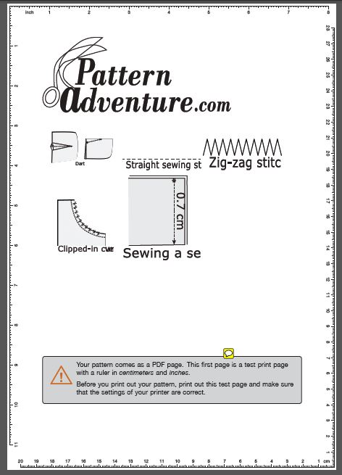
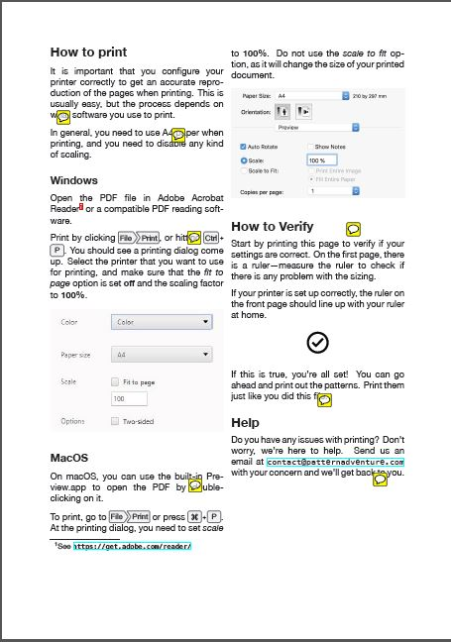

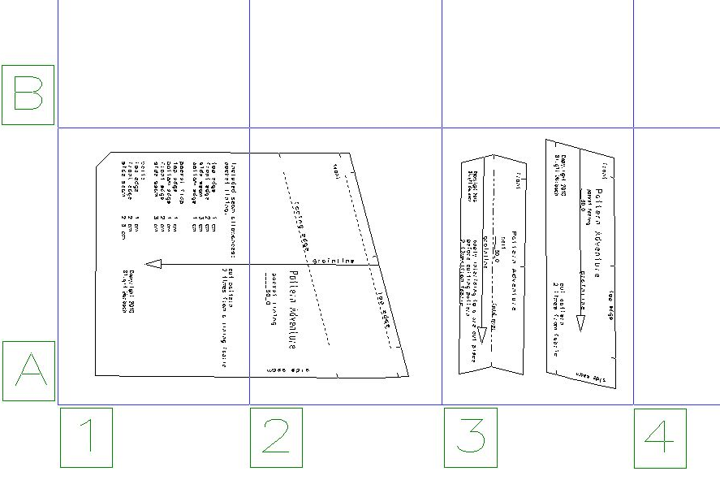
An up to date version is on the trello board: print test page
Test print page
Print pages
for customers
Sewing Pattern layout
on A4 sheets
Notes:
The customer need to have a test print page before they print the pattern.
The test print page should include a ruler in cm and inches. The rest of the paper can be used for a small project or info about something.

Slide 16
Sewing Pattern groups
Pants for Merino wool ready for testing
Elastic waistband
Tunnel waistband
Pants for Merino wool
Elastic waistband
Tunnel waistband
Straight hand pockets
Start March 2019
Outdoor pants
Elastic waistband
Pants pockets
Pants reinforcements
Zipper front + waistband
Start Jan 2020
Shirts
Dresses
Jackets
Sleeves
Hood/ collar
Pockets
Start Sept. 2019
13. Skirts
Notes:
I grouped the patterns, so we can concentrate on one part at a time.
Pants need in my opinion less measuremnts then shirts or dresses.
Jackets are even more complex, as I can think of a lot more different visual options of the designs.

Slide 17
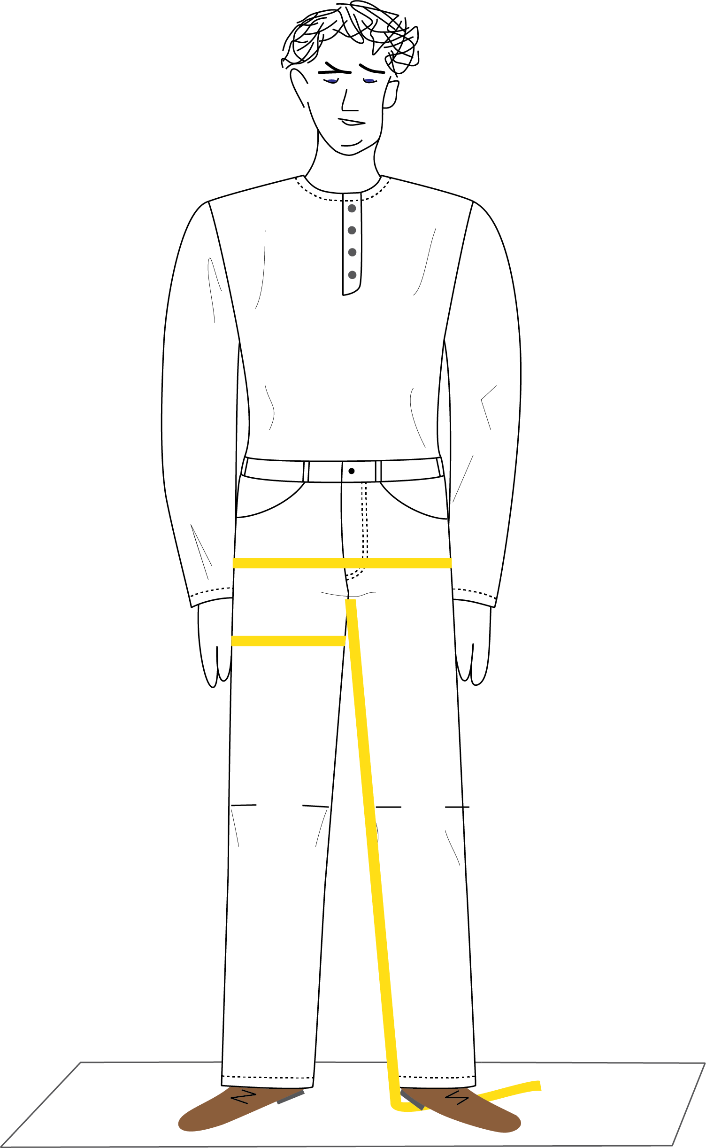
Sizing Calculator
Website Tools
Notes:
The sizing calculator should we working for women and men differently.

Slide 18
Specifications: Sizing Calculator
Customer perspective
Correct size
More individual sizes
Suggests small length adjustments
Single size print out
Better instructions on the pattern
Entered by customer
Certain measurements
Gender
Type of wear (looser or tighter)
Specific other information
Specifications
Place for customer to enter their measurements
Place to answer a few related questions
According to the measurements and questions answered:
Finds the correct size in sizing tables
Tells customer of any further small length adjustments
Provides right size pattern for download
Provides corresponding sewing instructions and sewing guidebook
Offers a material/ fabric amount list
Offers a fabric cutting plan
If pattern is not available, it is ”On demand” with in 72 hours
Send automatic email to BM
Connect to:
”How to measure yourself”
Notes:
The project is planned so, that the website is launched with the sizing calulator at first. The viualization tool is implemented later.
I need to provide you with information such as: - sizing charts, for women and men
patterns as PDF files in single sizes
Sewing instructions + guidelines
Material + fabric amounts
Fabric cutting plans

Slide 19
Back end (BE) stuff is not mentioned in the presentation.
BE should inlcude a database (+structure and an admin panel)
Desktop and Mobile devices
Needed for launch Front End (FE)
Product pages
Different categories for the different pattern groups
Ready patterns for download
Pattern on Demand (if pattern is not ready yet)
”AskTailorBirgit”
”How to measure yourself”
Text with drawings + photos
Video (later)
Sewing guidebook
Text with drawings + photos
Videos (later)
Courses
Local
Announcement ”New Course”
Info
Online classes (Later)
Adventure Gallery
Newsletter
About me, terms, privacy, payment, contact…
Website + Shop
More details are on the FE trello board, and talk to Veronika

Slide 20
Desktop and Mobile devices
Future Product Pages and Additions
Search
Easy to use Filter (when more products ready)
”We make for you” Patterns
Clothing
Website + Shop

Slide 21
Test print page
Sewing Pattern
Fabric cutting plan
Sewing instructions
Sewing guidebook
Material list
Measurements
Payment receipt
PDF downloable file for customer

Slide 22
Launch: Customer Pathway on the Website
Step 1
Step 2
= sizing calculator
Photo /image
of product
(Pre-designed
products)
Merino wool leggings
[Short despription:
Includes a sentence
about sizing calculator]
How to measure yourself
Hip: ____cm
Inseam:____ cm
Questions:
____
_____
_____
Pop up window? To the link
”Take your measurments”
Later guide through video
Find your size
Design your outfit
Included in the price
Pattern, downloadable
Sewing instructions
Guides -> link
Correct size (Sizing calculator: customer should be reminded how it works)
Material recommondation (link)
Material/fabric amounts
Price
Buy pattern now -> (Pattern on demand)
Notes:
This is the pathway I thought the customer would take to buy the pattern.

Slide 23
Step 3
Screen shot
of the pattern
Summery of taken measuremnts
Pattern, downloadable
Sewing instructions
Guides -> link
Material recommondation (link)
Material/fabric amounts
Buy now
Step 5
Step 4
Purchase + download confirmation
Instructions on download package
Via email or link (available for xx days)
Purchase + download
Privacy statement
Newsletter

Slide 24
Visualization Tool
Website Tools
Notes:
For this tool, I thought I create different drawings, but if you come up with a better idea....

Slide 25
Specifications: Visualization Tool
Customer perspective
Idea to visual design
Print out of the design
Correct pattern pieces
Matching sewing instructions
Fabric amount
Fabric + material suggestions
Cutting out plan
Specifications
Offers a design platform
Offers single ready designs for download, e.g. a certain pocket types
Offers a fabric choice/link for the design after a few questions answered
Customer designs his outfit from pre-designed drawings
Offers a print out
Find correct/ connects pattern pieces
Summary of pattern pieces needed
Find corresponding sewing instructions and guides
This tool interacts with the sizing calculator
Customer pathway on the web-site
Step 1 ”Design your outfit”
Notes:
I will create different patterns and moduls and I will create points on the patterns to be matched
The name of the pattern making program I use is Grafis. (grafis.com)

Slide 26
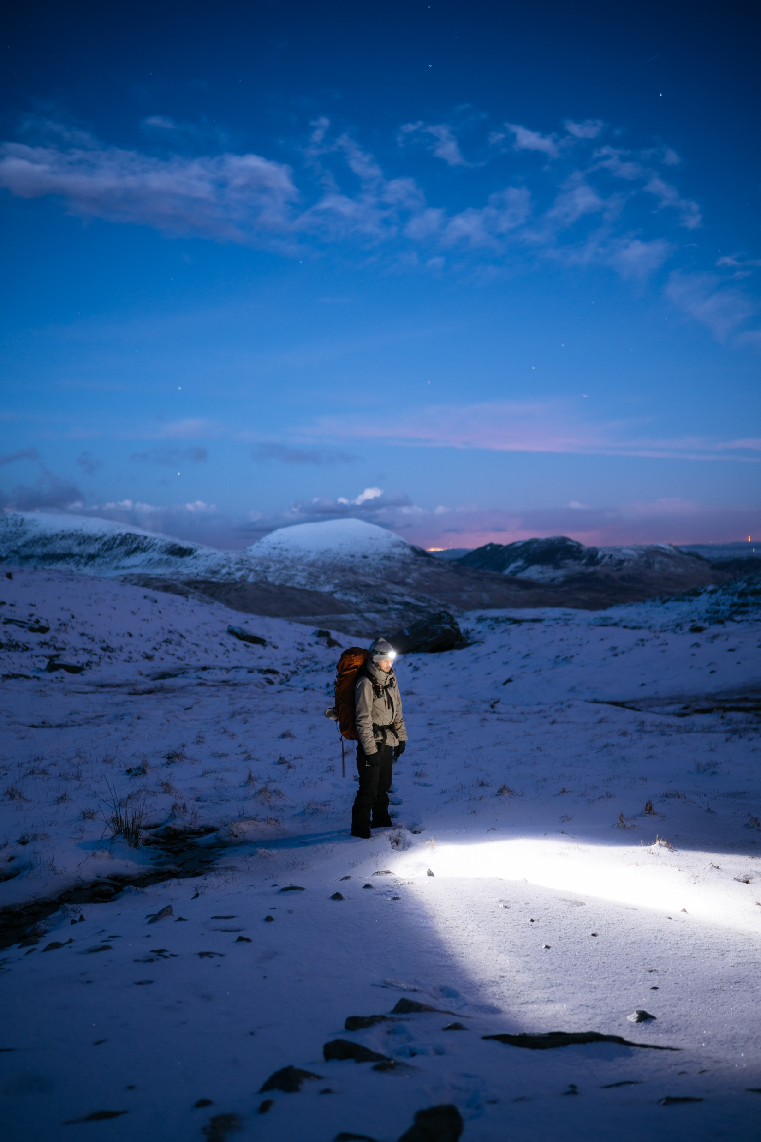
Thank you very much!
Birgit Marbach
040 745 2295
birgitmarbach@hotmail.com
Notes:
Thank you very much.

